Slide 1
Consumer Finance Protection Bureau Data

Slide 2
What the CFPB is
The Consumer Finance Protection Bureau keeps a database of all complaints submitted to them about consumer finance products.
The CFPB database has about 750,000 complaints in it.

Slide 3
Data Points in CFPB Database
Consumer finance product
ZIP code
State
Consumer issue with the product
Response of the company to the consumer
Timeliness of the complaint

Slide 4
Complaint Volume vs. State Population

Slide 5
Timely/Untimely and Disputed/Undisputed

Slide 6
Questions
What causes a consumer to dispute a response?

Slide 7
Method
Use the American Community Survey (ACS) economic data to get economic data for zip codes.
This should give us some useful information about the origin of a complaint.
Construct a random forest classifier to predict a disputed complaint.

Slide 8
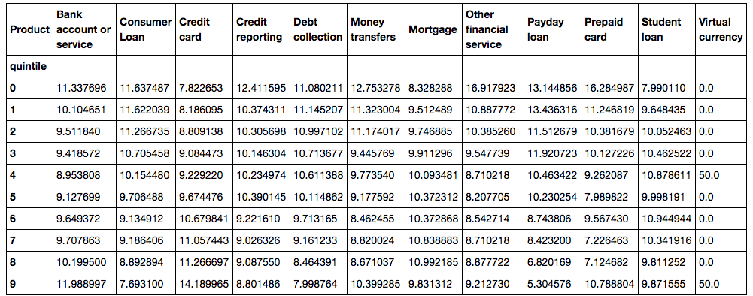
Income Deciles

Slide 9
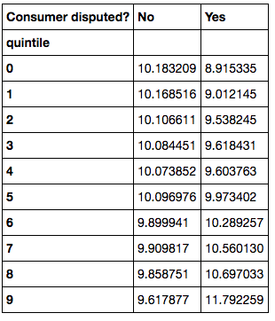
Disputes and Income Deciles

Slide 10

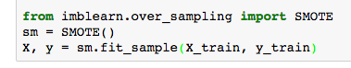

Building the Model

Slide 11
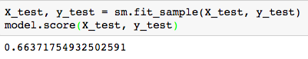
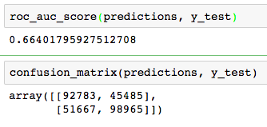
Results!

Slide 12
Results!
Income decile was among the most important feature
Consumer issue was also quite important—but this varies between issue. Some are more, some are less.

Slide 13
Future Directions
A more complex model—stacking and ensembling
Include more demographic data—age, race, etc.

Slide 14
Questions?

